Slide 1


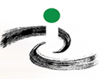
51st Chinna Shodha Yatra
by Palle Srujana
Anantagiri to Sarpanpally Lake
Dist Vikarabad, Telangana
17-19 January 2025
Background
Shodha Yatra, a journey of exploration, is a pilgrimage to the forgotten temples of Knowledge. We believe that villages and the villagers are highly knowledgeable and so to understand their expertise in “living in harmony with the ever changing nature” is the mission of Shodha Yatra.
The inspiration for Chinna Shodha Yatra (CSY) came from National Innovation Foundation (NIF). A group of participants walk for three days to interact with the nature and the people in the villages for learning, sharing and mutual exchange of knowledge. Please visit http://www.nifindia.org, www.pallesrujana.org and/or http://www.sristi.org for more details on Shodha Yatra.
Palle Srujana, a non-profit, non-government and a voluntary organization focused mainly on Rural Knowledge and Creativity, is the overall coordinator for the Chinna Shodha Yatras in Telangana and Andhra Pradesh. Since 2011, 50 Chinna Shodha yatras have been organized in Telugu states. Please visit http://www.pallesrujana.org for more details about the initiatives of Palle Srujana.
Fifty first Chinna Shodha Yatra (51st CSY)
Date: 17 to 19 January 2025
Location: Dist Vikarabad, Telangana
Meeting Point: Anantagiri
Starts: Yatra commences at 8 AM on Friday, 17 January, 2025 from Anantagiri village.
Ends: At Sarpanpally lake @5 PM on Sunday, 19 January 2025.
Total Distance: Approximately 50km.
Route map:
https://maps.app.goo.gl/pbPTKqLh9AogG5VcA

Slide 2
Registration: Please fill the form at the following link
https://forms.gle/JJBAR3CYsT6vrCK37
Please note that the registration does not automatically entitle participation in this Shodha Yatra. You shall be intimated if and when confirmed.
Last date for Registration: Noon, 16 January 2025
To reach the Meeting Point:
To reach the Meeting Point:
Anantagiri is 6 km from Vikarabad, the nearest Railway station is Vikarabad. Vikarabad is 70 km from Hyderabad. Autos are available from Vikarabad to Anantagiri.
Return Journey:
On 19 January 2025, yatries will be able to leave any time after 5 PM from Sarpanpally lake by road to Vikarabad which is the nearest Railway station. Travel time is minimum 30 minutes. Return reservations may be made accordingly.
Route we walk…..
17 January – Anantagiri – Kerelli – Dharur - Dornal
18 January – Nagaram - Momikhrud - Barkatpalle - Naskal
19 January – Dyacharam – Sarpanpally lake
The yatra area offers:
Paddy, cotton, maize fields, hills, Lakes, interactions with farmers and their women and children, many more…..

Slide 3
Objectives of Chinna Shodha Yatra:
Unlearn and learn
Promoting grassroots innovations
Observe the bio-diversity and its changes over the route
Observe the livelihood practices of Villagers.
Understand the harmony among the villagers and the nature.
Interact with villagers, learn and document their traditional knowledge.
Identify creative people in the village and document their knowledge.
Felicitate elders above 90 years at their door step.
Understand the villagers’ perspective on Development.
Observe resources availability and their utilization including value addition etc.
Assess the Self Reliance/Swayam Samruddhi practices.
Talk to children, and nurture creativity among them.
Assess the aspirations of village youth and their parents
Identify technology gaps and see the appropriateness of the tools and equipment being used by the villagers.
Study the crop pattern and examine their suitability to the environment, people’s needs and its sustenance.
Observe their food habits, health practices.
Traditional practices in treatment to animals and people.
Forest management and ownership of lands by tribal.
Share the knowledge of other villages which is captured by NIF and Palle Srujana.
Who can participate?
Participation in Chinna Shodha Yatra is voluntary.
School and College Students, any world citizen-male or female, boy or girl, who understands the mission of NIF, honeybee Network and Palle Srujana may participate in the Yatra. Visit www.nifindia.org and www.pallesrujana.org before volunteering to participate in the yatra.
Physical fitness to walk 50 kms during the Shodha Yatra is essential.
Registration Fee
Registration fee of Rs 500 per participant is to be paid at the beginning of the yatra which will be used against the pre-yatra expenses of planning and reconnaissance by Volunteers of Palle Srujana.
Logistics and food expenses during the yatra will be equally borne by the participants. Estimated expense is Rs 1000-1500 per Yatri depending on the strength. This amount will be collected at the commencement of yatra and one of the Yatries on voluntary basis will maintain the accounts and present the same to the group just before the conclusion of the yatra. Bring sufficient cash as the yatra area may not offer ATM facility.
Expenses during the Yatra
All participants including students should bear their respective travel expenses and local expenses. Food and logistics expenses will be shared equally by the yatris.
Yatra discipline needs to be strictly followed.

Slide 4
By registering into this programme, it is understood that you declare all the details that you furnished are correct and complete and in case you are student you have your parents consent. It is also understood that you abide
by the Palle Srujana’s mission and objectives of the Chinna Shodha Yatra along with its norms and discipline.
Participation is limited to minimum 20 and maximum 60. If more participants register, Coordinator will select the final list. Confirmation from the Coordinator is essential. Should the registered participants be less than 20, the yatra may get deferred.
Other Information
Food will be centrally organized. Each yatri has to deposit Rs. 1000-1500 for the food on the first day based on the number of participants.. Accounts will be tracked and settled by a volunteer from the yatris before dispersal on 27st October 2024.
Lodging during the three days is mostly free. We would sleep in a school, a panchayat office or a temple with no charges - courtesy village people but in very rare instances we may stay in a hostel and have to pay the expenses for stay.
During the Yatra, we will be felicitating the old, knowledgeable and deserving villagers with shawls and other useful items. Voluntary contributions from yatris are welcome for this purpose. You are welcome to bring shawls and other items. Cash sharing with villagers is prohibited.
Interaction with school children will be a major activity during the yatra. Idea competitions, bio-diversity competitions will be conducted for them. Volunteers are welcome to bring gifts like knowledge books, sketch pens, pencils, drawing books, pens, geometry boxes and other stationery and games kits for schools.
Recipe competitions will be conducted for the local women.
For more details, please write to anjireddy.boddu@gmail.com
Each yatri is expected to do the following:
  Maintain a positive attitude and shift to learning mode.
  Dress decently to ensure people are not attracted by our dress and gadgets. Look normal and try to merge with people.
  Keep active and participate whole heartedly.
  Interact with other participants extensively.
  Talk to villagers with respect and learn from them.
  Be courteous to women, children and old persons.
  Share impressions everyday and more on the last day.
  A detailed report on your impressions (along with your willingness to work in some activity of Palle Srujana) to be mailed by 31 October 2024. to
  Brig. (Retd.) P. Ganesham president@pallesrujana.org

Slide 5
What to carry
  1-2 sets of change of clothes
  Torch light with spare batteries
  Steel plate, tumbler and spoon
  Pad and pen/pencil
  Camera, video
  Bed sheets (2). Pillow(Only desirable)
  A Mug
  Water bottle
  Cap
  Suitable footwear – avoid new shoes
  First aid kit
  Medicines, if you are using any
  One luggage piece per participant will be carried separately in a logistic vehicle.
Useful Information
Kindly refer below for some important instructions/information for the Chinna Shodha Yatra:
Travel light and bring only as much luggage, which you can handle by yourself.
Sleeping gear has to be brought by the participant as it will not be provided
Mobile signals may not be available for most of the route
It is expected that during the Chinna Shodha Yatra, the participants should avoid walking with their friends/colleagues. The objective of this walk is to get to know other unknown yatries and local people and learn from them.
No waste material like food packets/ wrappers/polythene is to be littered in the jungles, villages or the places where we rest/sleep. Participants are expected to dispose such material, if in possession, at the designated place or carry in a bag for disposal later.
Closed bathroom/washroom facility may not be available.
Sometimes due to unforeseen reasons, food may be delayed. Kindly bear all this
in mind.
If we keep everything aforesaid in mind, Chinna Shodha Yatra would be a good learning experience for all. You will surely experience the excitement of living with minimal resources and facilities.

Slide 6
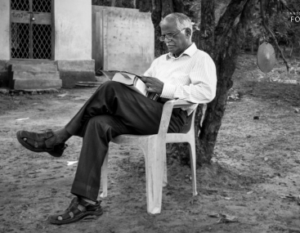

Mentor
Brig. (Retd.) P. Ganesham, VSM
President, Palle Srujana
Mobile: +91 9866001678
president@pallesrujana.org
Palle Srujana is a voluntary group based in Hyderabad. It strives to promote creativity at grassroots level in Telangana and Andhra Pradesh. Please visit www.pallesrujana.org for more details.
Our core activities:
  Scouting and supporting Grassroots Innovation
  Scouting, documenting and dissemination of traditional
  knowledge and healing methods
  Internships to anyone interested in learning from Informal sector
  Dissemination of grassroots knowledge through publishing a bi- monthly magazine in Telugu
  Exposing the Grassroots knowledge to school and college children and involve scientists, academia, economists, industry and other state actors in leveraging the sustainable benefit to the society from these innovations.
  Promoting entrepreneurship with grassroots innovations
  Seek problems and find solutions for the unmet needs of masses.
  Capturing Children Creativity.
Address:
77, Vayupuri, Road No 3
Post Sainikpuri
Secunderabad 500094
Telangana, India
Contacts:
Brig P Ganesham: 9866001678 president@pallesrujana.org
Anji Reddy: 9966646176 anjireddy.boddu@gmail.com
Murali, 8801477394, pavanvamisetti@gmail.com
www.pallesrujana.org

Slide 7
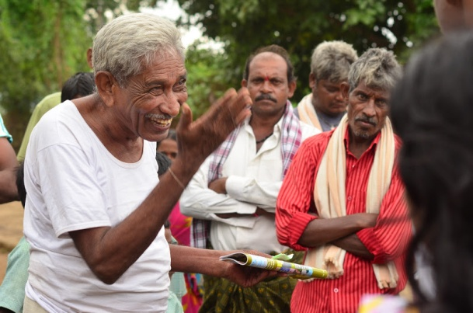
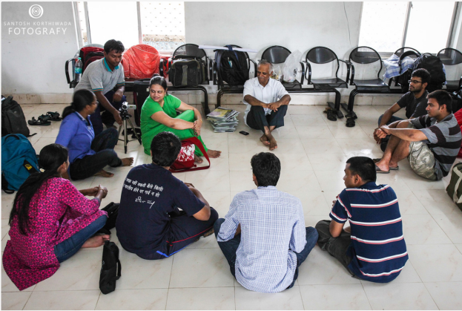
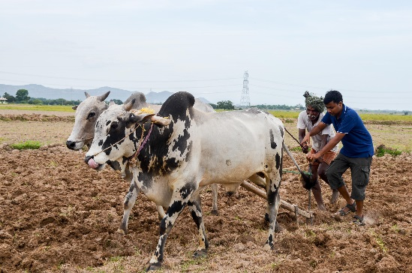
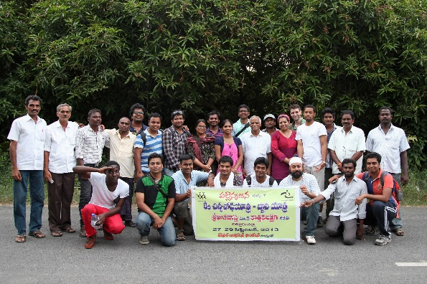
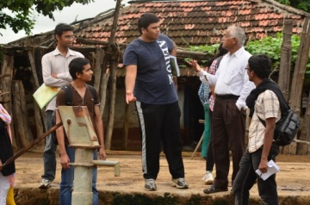
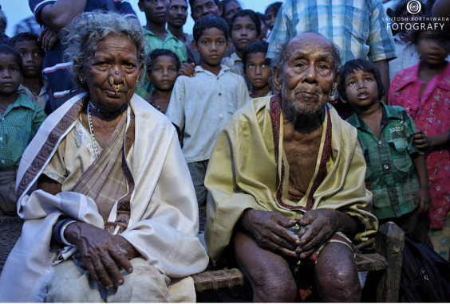
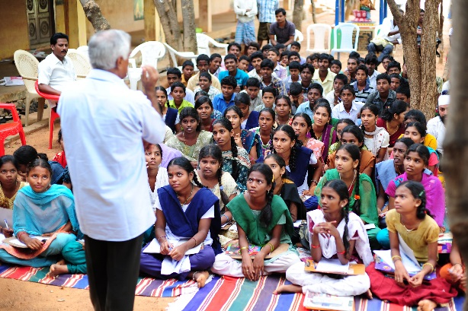
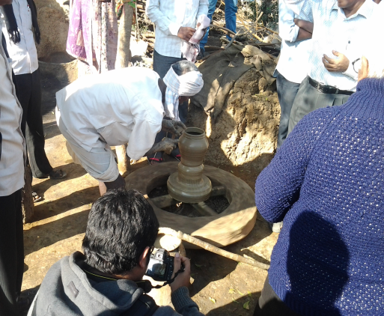
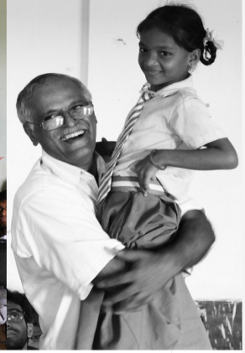
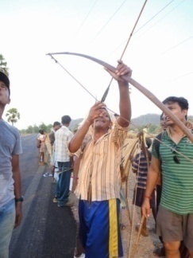
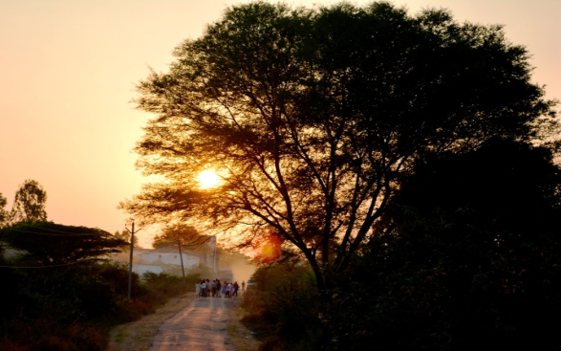
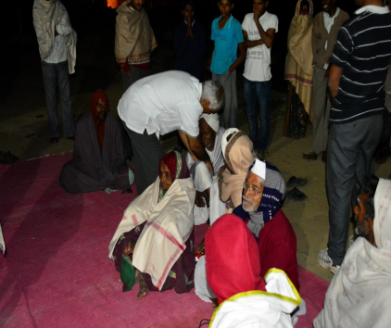
Moments from previous
Chinna Shodha Yatras

Slide 8
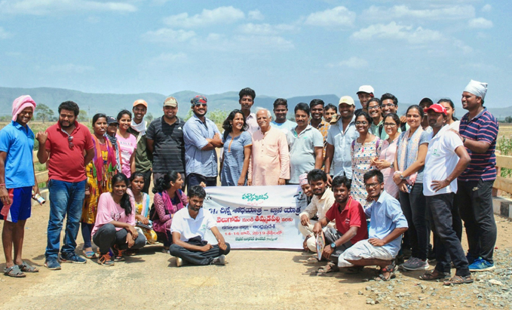
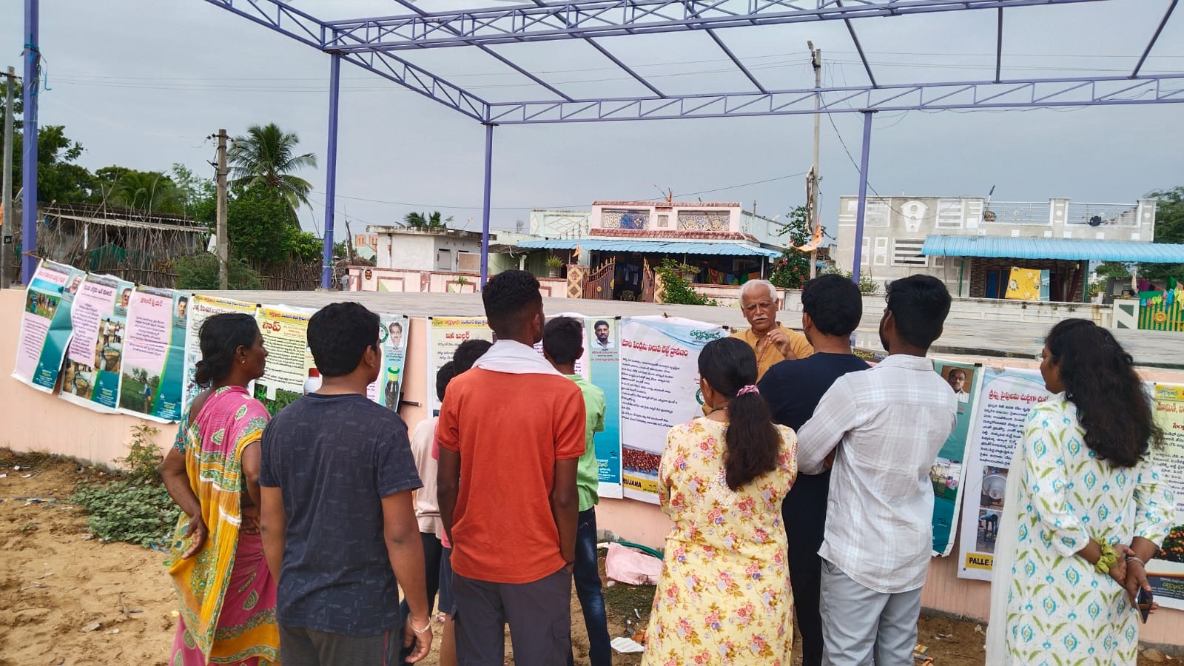
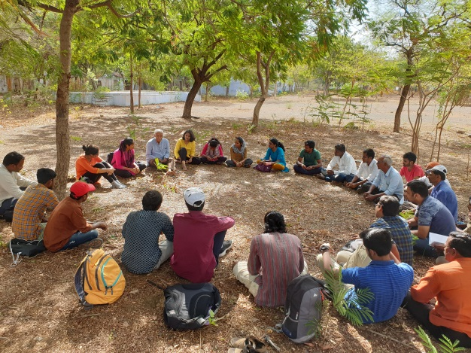
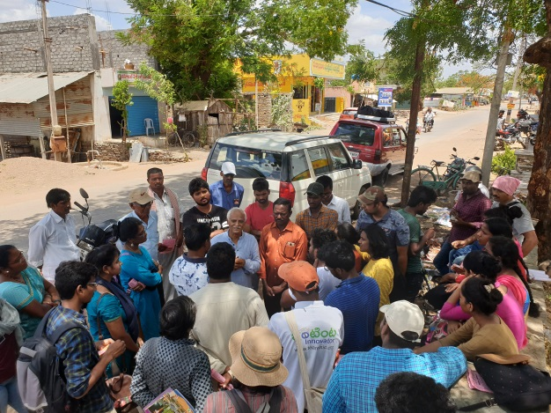
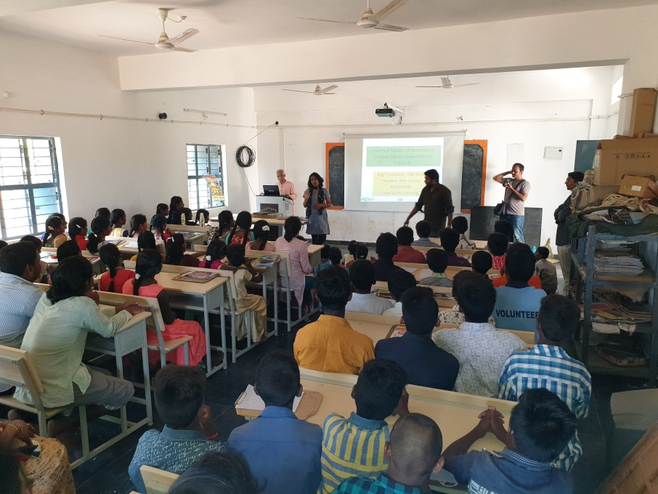
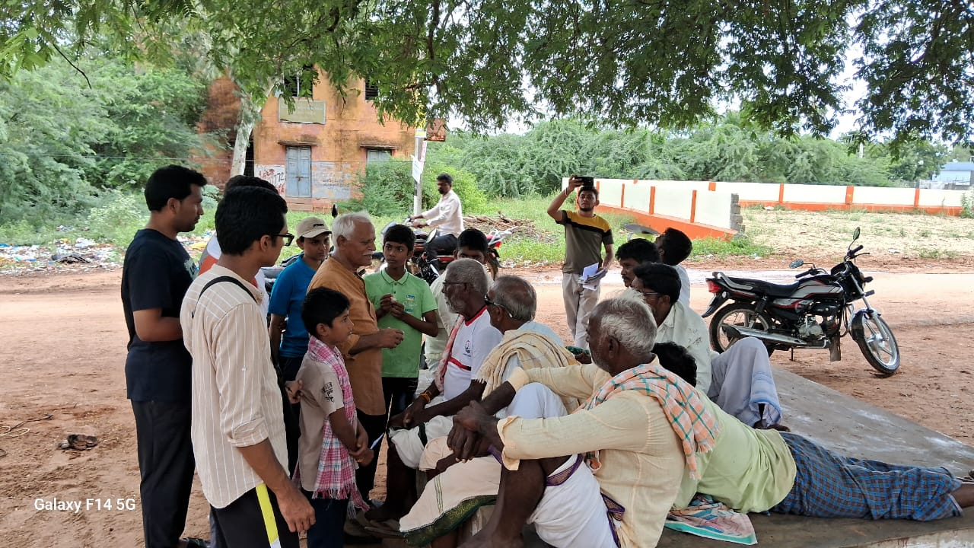
Moments from previous
Chinna Shodha Yatras

Slide 9
Previous Yatras
First Chinna Shodha Yatra was held in April- May 2011 in Duggondi Mandal of Dist Warangal. 23 students (6 girls) from NITW, MRIM and others participated. The feedback indicated that the objectives were fully achieved.
Second Chinna Shodha Yatra was organized during 18-20 November 2011 in Kothaguda Mandal of Warangal Dist from the historic Pakhal Cheruvu (Reservoir) constructed by the Rulers of KAKATIYA Dynasty, 800 years back for irrigation purposes to Gangaram through tribal belt and reserve Forest. 27 participants (5 girls) from NITW, Vagdevi Inst of Management, Two Professors made the Yatra very meaningful by their participation.
Third Chinna Shodha Yatra was held during 24-26 February 2012 in Mahabubnagar District. The Yatra commenced at Achampet and ended at Bakaram. 28 (including 4 girls) Participants from NITW, MRIM, Vagdevi Inst of Mgmt, Gurunanak Engg College, ITC etc made the Yatra a memorable one. The drought stricken, barren lands of this region provided us a deep insight into the livelihood strategies of the tribal people living in this area.
Fourth Chinna Shodha Yatra was conducted in Dist Khammam during 15-17 June 2012 from Chintur to Motugudem. 26 participants including a farmer, inter students, and students from NITW, IIIT, IIT, Kharagpur etc. A distance of 45 km was covered in deep forests and amongst adivasis.
Fifth Chinna Shodha Yatra was organized in Dist Karimnagar from Kataram to Mahadevpur during 02-04 November 2012. 32 participants explored the agri-belt and forests besides enjoying the flooded rivers and rivulets. Bath in the mighty Godavari River was the highlight of the yatra. Walking more than half the route in mud was a great experience.
Sixth Chinna Shodha Yatra was held in Adilabad district mostly in Tribal belt. During March 1-3, 2013 the yatra journeyed from DhannuraB to Indravalli. Age group ranged from 65- 16 years. 36 participants spent very useful three days interacting extensively with women, children, farmers and elders.
Seventh Chinna Shodha Yatra was conducted from Palakonda to Veeraghattam villages of Srikakulam District during 21st – 23rd June, 2013. 26 participants walked through a scenic green hills for a distance of about 52 km. Yatries were composed from a wide spectrum making the interactiion rich and varied.
Eighth Chinna Shodha Yatra was held from 27-29 September 2013 from SriKalahasti to Kotha kandriga in Chittoor District. 34 participants actively involved in the yatra and walked 51 kms. Few foreigners also participated in this yatra and shared their experiences as memorable and meaningful.

Slide 10
Ninth Chinna Shodha Yatra was held from 20-22 December 2013 from Nizampet to Narayanakhed in Medak District. 32 yatris walked 52 Kms along with two foreign participants from Japan and South Korea.
Tenth Chinna Shodha Yatra was held from Feb 28-Mar 2 2014 from Rajapet to Aleru in Nalgonda District. 30 yatris participated in the 50 km walk culminating in the residence of Innovator Mallesham.
Eleventh Chinna Shodha Yatra was held during May 9-11, 2014 Atmakur to Kapileshwaram, Kurnool District, About 20 yatris participated in the 50 km walk. For the first time, we’ve found innovators in the yatra.
Twelth Chinna Shodha yatra was conducted in District Rangareddy from Ibrahimpatnam to Mall during 20-22 June 2014. 18 Yatris from various parts of India and one from US participated. Innovations such as Solar sprayer and coconut climber were demonstrated live by the volunteers. The distance covered was 52 Kms and the area was very scenic with hills, lot of greenery, and valleys.
Thirteenth Chinna Shodha yatra had seen a lot of rain and yatris enjoyed walking in the rain for almost 4-5 hours at a stretch. The scenic Nizamabad district area from Varni to Tadakapally enthralled the participants with hidden treasures of knowledge and amazing people. It was conducted during 5-7 September 2014. 25 yatris including two from US participated.
Fourteenth Chinna Shodha Yatra - 24 participants went through an exciting route from Ulavapalla to Racharlapadu in Nellore Dist from 26-28 December. Shodha yatries had the privilege of seeing the process of salt making from ocean water. They visited astonishing "Child Ashram" on the last day and were moved by the pioneering work done for the rejected children of the society. In all the walk was 55 Kms long.
Fifteenth Chinna Shodha yatra was conducted from Parvathipuram to Sambara during December 26-28, 2015 in Dist Vizianagaram. 24 participants walked 52 Kms and interacted with the people of that region.
Sixteenth Chinna Shodha Yatra was conducted from Sunnampadu to Ramanayya peta in East Godavari Dist. The area was scenic and nature was in great display. 36 participants interacted with people from 12 villages during the three day walk from 25 to 27 September 2015. The area and the people offered immense knowledge to the shodha yatris during the walk of over 55 kilometers.
Seventeenth Chinn a Shodha Yatra - 46 participants walked 52 Kms from Kannapuram to Kondrukota from 8-10 January 2016. The route was through the Sanctuary and the yatries had experienced walking through thick forest and solitary spaces. Majority of the area we walked would be in the waters of Polavaram reservoir. It was an unique experience for the yatries to interact and learn the difficulties these people face in their rehabilitation.

Slide 11
Eighteenth Chinn a Shodha Yatra was conducted in swelterng heat during month of April 2016 in a valley of Prakasam District. The yatra started from Cumbam and reached Gannepally after three days. Over 22 participants interacted with people from 18 villages and enjoyed the hot and cold days in the region. Hospitality of the people stole the hearts of the yatries.
Nineteenth Chinna Shodha Yatra was held in June 2016 from V.N Palle to Gangireddi Palle in Kadapa dist of Andhra Pradesh. 36 participants walked 55 kms and enjoyed the hospitality of the locals, interacted with villagers to learn and share the grassroots knowledge and enjoyed the nature found during the route. Children creativity was documented by the yatries. Interaction with women in the villages was very meaningful. Three scientists from CSIR also walked in this yatra.
Twentieth Chinna Shodha Yatra - over 45 participants got together on 24 September at RDT premises in Atmakur, Dist Ananthapur. Next 3 days upto 25 September, yatries walked over 50 kms starting from Hanimireddypalli and concluded at kambalapalli. This was a very meaningful yatra where yatries could meet innovators, herbal healers and were overwhelmed with their knowledge and hospitality. Weather was perfect for walks and green fields with mountains as an excellent backdrop. The drought prone area gave yatries an insight into the inner strength of the people to survive and live in harmony with nature.
Twenty First Chinna Shodha Yatra - 38 Particiapnts participated in this gyan yatra passing through around 20 villages starting from Repalle -Peasarlamaka- Bhattiprolu- Palle Kuna and back to Repalle in Dist Guntur of Andhara pradesh state. The verdant nature with full of cultivation, people with excellent farming skills and caring hospitality and abundant creative energy in the children, women and farmers humbled the yatries. We found three innovators and felicitated then at their door step.
Twenty Second Chinna Shodha Yatra - This Yatra was planned to be in the forest region of northern Warangal dist. 42 of us spent more time with trees, bushes and birds than with people. Lunch on a hill overlooking Jampanna Vagu curving through the reserve forest skirting hills and the discussion followed were exciting and inspirational. Interaction with school children and children was thoroughly enjoyed by yatries. Passed through the very popular shrine and Mela location "Sammakka Sarakka jatara" and interacted with moolika vaidyulu. As the Yatries walked over 50 Kms, there was a great exchange of knowledge with Nature and people. Many questions regarding the human behaviour to wards the nature were raised and some found answers and some were left unanswered. Nature in its pure and gigantic form presented to the Yatries during this Yatra remains the most memorable experience.

Slide 12
Twenty Third Chinna Shodha Yatra - From Nirmal to Khanapur in Nirmal District of Telangana, 22 yatries walked over 52 Kms for three days. This Yatra was unique in the sense that each day we met one innovator and one old person above 90 years. Yatries learned from them with excitement and also were stunned to note the quality and depth of the knowledge these people possessed. Interaction with the young farmer Prabhakar was one of the highlights of the yatra.
Twenty fourth Chinna Shodha Yatra – 26 Yatris joined this yatra which commenced from Zaheerabad to Basanthpur in Sangareddy District, Telangana. Experiences during yatra were amazing as the journey included visiting “Aranya” – a permaculture Institution, Meeting Smt Tuljamma - a simple but extremely helpful to the society, Konda reddy a septugenerain who walked faster than all the yatris and shared amazing anecdotes of his times. Yatris also visited DDS – a four-decade old organization dedicated to preserve and promote local seeds and millets for farming and consumption. We found few innovators too and documented the knowledge of herbal healers. Interaction with children was least due to School holidays.
Twenty Fifth Chinna Shodha Yatra - This was a unique yatra for many reasons. Firstly, 46 participants with 11 women/girls was a record for all yatras. It had two youngest Yatries Rudra and Nilaya in their fifteenth year. The yatra also saw very low temperatures upto 4 degrees centigrade at Lambasingi on the second day night. The group walked 58 Kms and passed through some very remote, pristine and with simple people inhabiting the place. Every yatri was excited to walk and learn through interaction with people and witnessing the nature and love of the locals. We had some amazing moments when a dog - nick named CSY followed us for 16 kms on the last day.
Twenty Sixth Chinna Shodha Yatra - 46 yatries from various walks of life and of all ages with a dozen girls and ladies started the yatra from Nagayalanka in krishna dist from the banks of River Krishna. Three days walk upto Hamsla Deevi included visiting over dozen villages, interaction with students in 3 schools, crossing River Krishna twice ona ferry with many vehicles and people, spending a night on an island, walking in the moonlight on KARAKATTA which runs parallel to the Bay of Bengal, visiting Sorla Gundi village which lost over 600 people in two hours during 1977 cyclone. Finality was when yatries immersed themselves in the sea at Hamsala deevi on the last day before the yatries bid farewell to each other. Interaction with women was very significant and the life of fishermen was the focus of the yatra. Walking through mangroves was an experience having understood how they help people living in its to proximity.

Slide 13
Twenty Seventh Chinna Shodha Yatra - 34 yatries walked over 58 Kms in Nagar Kurnool dist starting from Peddakothapalli to Somasila. They interacted with school children, farmers and women. We met a farmer in the village who expressed his anguish at the unviability of farming due to high input costs and low price for farm produce. A women shared how happy she is being in the village as everyone knows everyone and care for each other. Somasila - a scenic place located on the back waters of Krishna from Srisailam Dam was the best place for culmination of Yatra.
Twenty Eighth Chinna Shodha Yatra - 36 Yatries gathered at Valivetivaripalem in a Brick making farm ten kms away from Ongole, the district capital of Prakasam Dist. An unlearning session in the morning brought us together for the first time. Next three days journey followed was a memorable as the nature and people opened their arms to extend hospitality, share their knowledge, displayed their skills, described the pains underlying the livelihood practices, humbly convey the apathy of the system and formal people. Women, men, children and elders were very kind to us all through the Yatra. Night halts on the side of the river and in Temple were the most peaceful. Small hotels provided the best and tastiest food at unbelievably low cost. All through we could see the emphasis was on people - their happiness and well being. Yatries learnt about brick making, river fish catching, sea fish catching, crab catch and process, harvesting in sandy soils etc enroute interacting with fishermen, farmers and brick makers. E met elders baove 90 years and took their blessings and listened to their life story. This yatra also saw 5 inmates from local Orphange "Bommarillu" participating very actively and gave all of us tremedous pleasure and an intellectual company.
Twenty Ninth Chinna Shodha Yatra - 34 Yatries collected at the Innovator Shanmukha Rao’s house in Kambalapally village on the morning 21 December 2018. The journey began with an intense interaction with students of local school. Yatra went through a fairly cultivated area, beautiful hills and river beds, mostly through Pakhal reserve forest. Another innovator S Babu interacted with yatries and described his simple but very useful innovation. Enroute, yatries met many young farmers, which is rare nowadays, shepherds, school students, women and teachers. Visit to Bheemunipadam was a bit disappointment as the expected water fall was missing. Walk in the pure moonlight was bliss for all. Silent walk and walk through dark nights in unknown villages with utmost safety and security made all of us feel that villages by default are safer than over protected urban areas. A 48 Km walk was worth it.
Thirtieth Chinna Shodha Yatra - The coastal district of Srikakualam was in the news lately for not so good reason. Cyclone Hudhud caused substantial damage to the age old coconut and cashew trees and took away the livelihood from thousands of farmers in the coastal region of the district. The route we took was closer to the cyclone affected area. People appeared to have overcome the loss and resumed their lives as usual. Ponduru , the starting point of the Yatra is famous for Khadi and in the last century, majority of politicians wore kurtas made

Slide 14
of Ponduru khaddar visit started from a weaver's house and ended at Naira north east. We had the privilege of crossing the flowing rivers Nagavali and Vamsha dhara. Yatries bathed in the river and overwhelmed by the beauty of nature. Villages were clean and the plastics are seen less. To our surprise we found no liquor or meat shops in villages, though towns still house them. Young men and women have migrated to cities mostly Hyderabad leaving the seniors and elderly to cultivate the lands and hold on to the village property. In this region only one crop is possible due to rain fed irrigation and mostly Seasame, Minimulu (Urd), maize besides paddy are grown . People are very jovial and their unintended sarcasm in normal conversation is something to experience. Most of the villages depend on ground water tough bore wells for drinking and irrigation. Schools have newly constructed compounds, and each village has a modern cremation ground besides a waste recycling unit. These were constructed by the Govt using NRI funds. Purchasing power of people in this region is high and generally found them happier and healthier. Local hospitality was overwhelming.
31st Chinna Shodha yatra - Area we walked was adjacent to the Nallamala Forest and Mahanandi with its perennial water flow irrigates many acres of this region. Locals are fortunate to have KC canal in the region providing irrigation to large farm lands. 39 yatries from various parts of the Country participated in this yatra organized in the hinterland of Kurnool dist. The major crop is Paddy and the soil is mostly black cotton. Animals are few and farmers depend upon tractors and harvesters for cultivation. While the advantage of mechanization is evident, hidden losses caused by engaging heavy automation even for small holdings. One unique feature which disturbed all the yatries was almost total absence of trees beyond village periphery. Our walk was painful as no shade was available and this is the first experience for us among all the yatras so far.
32nd Chinna Shodha Yatra - We found it a blessing to see the entire route fully green with crops, water flowing streams, slushy path, hills and valleys, walk in dense forests in rain and under the starry light in the night amazing children with bubbling energy and simple and creative people in the villages. In Pocharam we met a farmer innovator - Pichaiah who not only shared his innovation but also made a new one and presented to us for display in other villages. How simple can an innovation be? 36 Yatries walked with spring in their feet, enjoying the surrounding nature as blessing, engaging with villagers, children and the co-yatries. The walk was a bliss with nature providing us amazing experiences every hour, every day and all days. Good thing about the region is that there is plenty of work in the villages and hence migration appears to be least.

Slide 15
33 Chinna Shodha Yatra
This was by far the yatra with maximum participants. 62 Yatries from the age 8 to 70 was the enthusiastic group which walked from Ramachnadra Puram to Gangudupalli in Chittoor district of Andhra Pradesh. Journey passed through small villages, vast fields, hills and streams, sometime empty canals. The nature was astounding with its diversity and variety. Yatries met, Sheppards, potters, farmers, women and children who shared their knowledge and creativity with unprecedented care and affection. Our big size was never a problem for them. Hospitality was its peak and all yatries were totally impressed by the villagers’ friendliness to invite us, talk to us and share what they have on their own to unknown people. Three days and nights were full of life, activity, energy and knowledge. Participants shared their mazing observations with all others every night and let all know what each one had learnt. This has been a second yatra in Chittoor district and surely remains memorable.
34th Chinna Shodha Yatra – Yatra started from Bhupalpally with an interesting interaction with the collector of the district. Yatries almost 60 in number had a great diversity in terms of age, education, professions and perspectives. Youngest was a girl 7 years and the oldest was of course 70 years old Brigadier. Together, yatries travelled through thick forests, valleys, green hills, crossed streams and walked alongside the green fields. Rains come suddenly and lift the spirits of those who felt tired of walking and none goes to hide from rain. Bright Sunshine follows and each yatri enjoys the bliss of nature all the three days. Silent walk in the night taught all yatries something unique. People were friendly and they looked content with what they have. Nature has been very generous to them in terms of plentiful flora and fauna besides Godavari river flowing through the district. Yatries found a young innovator and also few eminent herbal healers. Yatries interacted with women, elders and children besides farmers in over a dozen villages. This being the biggest group in any yatra, our apprehensions of logistic hiccups did not happen as each yatri contributed and cooperated extremely well.
35th Chinna Shodha Yatra
About 60 kms of walk-through reserved forest filled with hills, valleys, dense forests and small inhabitations of tribes was witnessed by the 41 Yatries participated in 35th Chinna Shodha Yatra. It started on the Christmas Day and continued till 27 Dec. Yatra commenced at Bayyaram and ended at Gangaram of Mahabubabad dist of Telangana. Seven women yatries comprising of students, scientist, professors and social activist were part of the group and brought the women perspective into the discussions very effectively. Yatries could meet an innovator, a child prodigy who makes amazing models, few herbal healers and a grand old man “Papaiah – over 85 years” who blessed the yatries with his knowledge, and experiences of his long life. Despite the pandemic, villagers welcomed us with warmth and shared their aspirations and hurdles to achieve them. Village sarpanches were very cordial and organized the interaction of Yatries with villagers. Moonlight made our night walks highly pleasant and memorable. Various discussions among the yatries added value to the overall outcome of the yatra. Another memorable three days spent in the lap of nature, and most hospitable people.

Slide 16
36th Chinna Shodha Yatra
35 participants comprised of children of age 7 and 9 years. It was unique in this context. The route was a mix of hills, valleys, streams and plains. Plenty of horticulture farms, and organic farms. Interacted with permaculture, organic farmers who are seriously practicing their beliefs and took pains to explain their philosophy. A great deal of interest generated in the yatries while interacting with these practitioners. Visit to few villages was beneficial and interacted with few elders above 90 years and took their blessings. Visit to schools was exciting as the children not only enjoyed the innovation display but expressed many creative solutions to the problems, they found around them. Scientists who participated in the yatra shared their experiments and enlightened the yatries.
37th Chinna Shodha Yatra
Nalgonda district offered a soothing weather all the three days. 33 yatries with the support of local volunteers have visited villages, thandas, Krishna river and concluded at Nagarjuna Sagar Dam. 18 Gates of the Dam were opened at the time of the conclusion of the yatra. Yatries visited a rice mill, talked to the migrant labour and comprehended the nuances of making paddy into rice of different varieties. Interacted with elders nearing hundred years and sought their blessings and knowledge. Witnessing the Tribal festival being celebrated in thandas was the highlight of the yatra. Villagers have shown a lot of interest in the innovations displayed by the yatries. Interacted with three innovators enroute and impressed by their passion to solve the problems of locals by their creativity. Few Thandas have stones in their fields and Palle Srujana offered a simple machine to remove the stones from the field. The variety and diversity of people and nature made the yatra learnings very rich.
38th Chinna Shodha Yatra
43 Yatries gathered to learn from the people of Anantapur district. Fortunately for the yatries, weather all three days was pleasant and greenery around the path they walked kept the spirits of yatries high. Yatries interacted with RDT – a NGO working for the last fifty years and brought a impressive change in the attitude of people in this district. Yatries felt the contribution of RDT highly laudable. Interaction with farmers, children and women was meaningful. Availability of water by rain water management in villages was the highlight. Shop keepers, artisans, teachers and parents shared their knowledge and experiences in Covid period. Yatries met few Innovators and impressed by their creativity to find solutions to their problems. Innovators Vijay Kumar, Gurumurthy Chetty interacted intensely with yatries on second and third day. Yatries were bowled over by their simplicity and passion and high approach to problem solving in simplest manner. Impressions of Yatries revealed that there was a meaningful learnings and knowledge sharing during the yatra.

Slide 17
39th Chinna Shodha Yatra
It was river Godavari which attracted 33 yatries to 39th CSY which started from Tadvai and ended at kamalapuram. Whether was at its best and the local volunteer Karthik made the yatra meaningful by his local knowledge , connectivity. Yatries were overwhelmed by the imposing nature, vastness and serenity of river Godavari and Mirchi crops across thousands of acres around Mangapet. Our interaction with village men and women was very meaningful and cordial. Hospitality of villagers was inspiring. We scouted two innovations and a lot of traditional knowledge. Children's creativity made yatries pleasantly surprised. Impressions of yatries were deep and the camaraderie was at its peak. Most yatries felt that three days is too less for the yatra duration.
41st Chinna Shodha Yatra
An inquisitive, a bit senior in average age, full of passion to know the unknown were the characteristics of the around 20 Chinna Shodha yatries who participated in the 41st Chinna shodha yatra. It included four energetic women. The yatra started in Narayanpet district and concluded in Gadwal district. Region was not much used to modern agri-machinery and mostly rain fed area. Rice is the major crop and farmers are found to be using mostly old methods and not found to be engaged with innovations. Our demonstrations drew a large group of farmers in each village we visited. Local Support from the Sarpanch and other leaders was of very high order. Local needs were identified and yatries felt that grassroots innovations can help them increase their productivity with least cost. Yatries also interacted with school children and local elders. Farmer Gangappa was so assertive in stating that he and his family work in his fields and use less machinery and no chemicals, yet he is making profits and buying plots in the nearby town every year. It was so heartening to see the assertion of the farmer. We met teachers, women and few herbal healers and interacted with them. In kalval village, spontaneous support from the Sarpanch Maheshwar Reddy was unique. When challenged to find innovators from his village, he took it seriously and connected us to Makthum Mohmmed within 24 hours after a serious search in his village. This innovator has made a stupendous sprayer by combining the tradition and modern technology. One more innovator too got connected with yatries two days after the yatra got concluded. Short group with deep involvement and inquisitiveness made 41st yatra quite memorable with many learnings and and eye openers.
42nd Chinna Shodha Yatra
43rd Chinna Shodha yatra
44th Chinna Shodha Yatra
45th Chinna Shodha Yatra
46th Chinna Shodha Yatra
47th Chinna Shodha Yatra
48th Chinna Shodha Yatra
49th Chinna Shodha Yatra
50 Chinna Shodha Yatra

